Slide 1
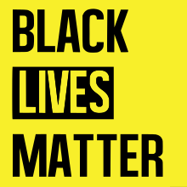

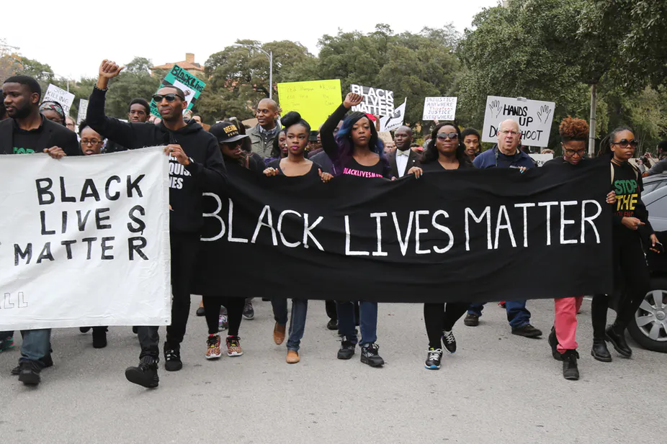

Black Lives Matter
The Black Lives Matter Global Network Movement is member-led organization that originated in the African-American community whose mission was to build the local power, stop racism and to intervene in violence inflicted on Black communities by the state and vigilantes.
The movement begun in August 2014, a week after Michael Brown, an 18-year-old African American, was fatally shot by a white police officer. The protests lasted for months and were a seminal moment in the evolution of social movements.
The movement resulted from the collective labor of a wide range of Black liberation organizations, each with their own distinct histories purpose. These organizations include groups like the Black Youth Project 100, the Dream Defenders etc..
WHY Black Lives Matter Movement
Globalism -we see ourselves as part of the global Black family and we are aware of the different ways we are impacted or privileged as Black folk who exist in different parts of the world.
Black Family - we are committed to making our spaces family-friendly and enabling parents to fully participate with their children. We are committed to dismantling the patriarchal practices which keep Black women silent.
Black Villages -we are committed to disrupting the Western-prescribed nuclear family structure requirement by supporting each other as extended families and “villages” that collectively care for one another.
Restorative Justice - committed to collectively, lovingly and courageously working vigorously for freedom and justice for Black people, and by extension, all people.

